Slide 1

Paper ID:723
Presented by
Tanushree Dwibedi,
Nandana Devi,
Smita Rath ,
Monalisa Panda ,
Deepak Kumar Patel
Department of Computer Science & Information Technology
Faculty of Engineering & Technology(ITER),
Siksha ‘O’ Anusandhan Deemed to be University, Bhubaneswar, Odisha

Slide 2
Presentation Outline
Introduction
Motivation
Objective of the Problem
Data set description
Configuration of system
Architecture of LSTM and bi- directional LSTM
Important features used
Hyper parameter table
Simulation
Result and Discussion
Conclusion
Reference

Slide 3
Introduction
The stock market allows investors to analyze a company’s current and future financial value, offering better returns than savings or bonds.
Artificial intelligence (AI) and machine learning (ML) analyze large datasets, identify trends, and improve stock market forecasting.
Techniques like neural networks, natural language processing (NLP), and sentiment analysis are applied to news, social media, and stock prices for better predictions.
This paper uses a BiLSTM (Bidirectional Long Short-Term Memory) model to predict closing prices for Meta, Amazon, Apple, and Tesla using Yahoo Finance data.
The study demonstrates BiLSTM's ability to capture patterns and outperform traditional forecasting methods.

Slide 4
Literature Survey
Traditional stock prediction methods include statistical models like ARIMA[1], Exponential Smoothing[2], and GARCH[3].
These assume linear fits under stable conditions, which are rare in real-world data.
Ensemble methods, such as Random Forest (RF)[4], Gradient Boosting Machines (GBM)[5], and XGBoost[6], improve accuracy by combining multiple models and capturing non-linear relationships.
While ensemble methods are effective, their performance on noisy, high-frequency financial data is less explored.
Comparative studies on optimizers and loss functions for financial time series are also lacking. Future research could test BiLSTM with different optimization strategies.

Slide 5
Motivation
Traditional methods like Simple Moving Average (SMA), RSI, Bollinger Bands, EMA, and Linear Regression have been used for decades.
These rely on historical data, have low predictive power, and ignore external factors like sentiment or macroeconomic indicators.
The primary advantage of LSTMs over Random Forest, Gradient Boosting Machines (GBM), and XGBoost is their superior ability to handle sequential data and capture long-term dependencies within time series data.
These methods capture non-linear relationships, integrate diverse data, and improve accuracy.
LSTM neural networks are especially effective for sequential data and time-series trend prediction.

Slide 6
Objective of the problem
This paper presents a deep learning model-BiLSTM (Bidirectional Long Short-Term Memory) neural networks to predict the closing prices of main stocks: Meta, Amazon, Apple, and Tesla.
The study leverages socioeconomic data as predictors to improve the accuracy of the forecasts.
Comparative analysis is done on the performance of six well-known optimization algorithms in the Keras machine learning library—Adam, Adagrad, Stochastic Gradient Descent, RMSprop, and others—that are utilized to train the LSTM model.
Performance metrics, such as MAE and RMSE, are used to evaluate model performance.
The results allow one to understand the most efficient method for optimizing the prediction of stock prices and practical implications in terms of offering data driven strategies for decision-making by financial analysts and investors.

Slide 7
Data Set Description
Stock Data of Four Companies :Tesla, Meta , Apple( 'AAPL', start='2023-01-01', end='2024-01-01’) ,Amazon
Count: Number of trading days in the dataset.
Mean: The average value of each column.
Standard Deviation (std): The variation in stock prices.
Min & Max: The lowest and highest values.
Quartiles (25%, 50%, 75%): Percentile distributions of the data.

Slide 8
Data Set Description (contd..)
AAPL stock each day:
Statistic | Open | High | Low | Close | Adj Close | Volume
Count | 250.00 | 250.00 | 250.00 | 250.00 | 250.00 | 250.00
Mean | 172.25 | 173.85 | 170.98 | 172.54 | 171.28 | 59,217,030
Std | 17.53 | 17.26 | 17.53 | 17.33 | 17.41 | 17,773,920
Min | 126.01 | 127.76 | 124.16 | 125.01 | 123.71 | 24,048,300
25% | 161.55 | 162.38 | 160.69 | 162.11 | 160.67 | 47,812,080
50% | 175.24 | 177.02 | 173.84 | 175.47 | 174.38 | 55,077,500
75% | 186.80 | 188.09 | 185.17 | 187.33 | 186.26 | 65,742,920
Max | 198.02 | 199.61 | 197.00 | 198.11 | 197.14 | 154,357,300

Slide 9
Configuration Of System
Hardware configuration-
The experiments were conducted on
OS Microsoft Windows 11 system
Version 10.0.26100 Build 26100
System Model HP Laptop 15s-dr2xxx
System Type 64-bit
Equipped with an Processor-Intel(R) Core(TM) i5-1035G1 CPU @ 1.00GHz, 1190 Mhz, 4 Core(s), 8 Logical Processor(s)
With installed RAM 8.00 GB (7.79 GB usable).
Software configuration-
The program runs on
Python 3.12.3 , conda 24.5.0 . The implementation leveraged TensorFlow 2.18.0 for deep learning, and Scikit-learn 1.4.2 for data preprocessing.

Slide 10
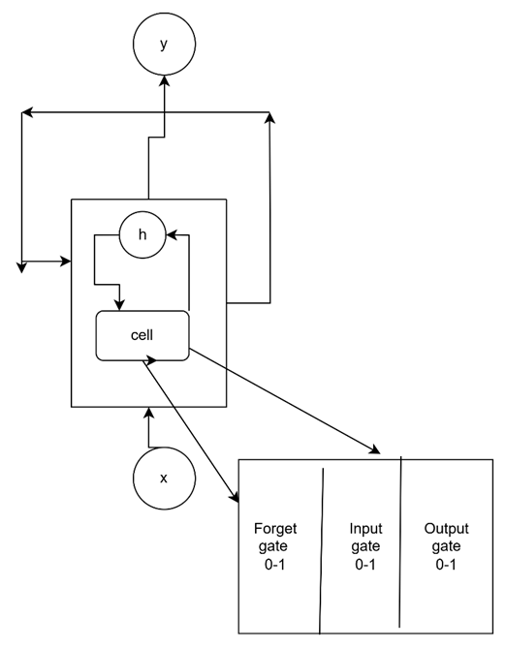
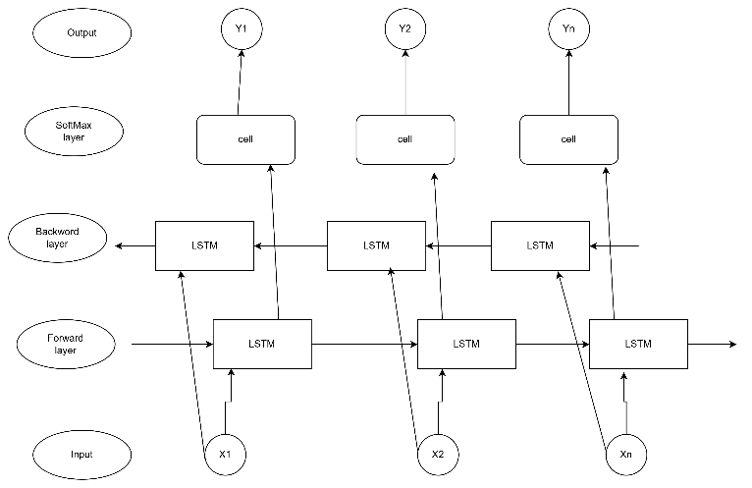
Architecture Of LSTM vs BiLSTM
Fig 1: LSTM Architecture
Fig 2 : Bidirectional LSTM Architecture

Slide 11
Advantage Of using LSTM model
LSTM is advanced version of RNN specially proposed to overcome the inability of RNNs to capture long term dependencies properly and also problems like gradients vanishing .
Unlike traditional RNNs, which rely on only a single hidden state, the LSTM incorporates a memory cell that allows the model to retain and manage data for longer periods.
The memory cell Incorporates specialized gates (Forget, Input, and Output) to handle temporal dependencies and avoid vanishing gradients.

Slide 12
Working of BiLSTM
Bidirectional LSTM (BiLSTM) is an extension of the traditional LSTM that involves two LSTMs running in parallel, one processing the input sequence from start to end (forward direction) and the other processing the sequence from end to start (backward direction).
Forward LSTM: Processes the input data in the forward direction.
Backward LSTM: Processes the input data in the reverse direction.
Combined Output: The outputs of both the forward and backward LSTMs are typically concatenated or summed to form the final output.
Bidirectional-LSTM: reads the input sequence in both forward and backward directions.
This allows the model to learn context from both past (previous time steps) and future (next time steps) data
In terms of computational time and accuracy, BiLSTM emerged as the more effective model for stock price forecasting as compared to LSTM.

Slide 13
Table 2. Hyper parameter Tuning using Different Optimizers
Hyper Parameter Tuning
Table 1. Hyper parameter Tuning using Different Optimizers
Optimizer | Learning rate | Batch Size | Epoch
Adam optimizer | 0.001 | 32 | 1000
Adam optimizer | 0.0001 | 64 | 2000
RMS prop optimizer | 0.001 | 32 | 1000
RMS prop optimizer | 0.0005 | 64 | 2000
SGD optimizer | 0.01 | 32 | 1000
SGD optimizer | 0.001 | 64 | 2000
Adagrad optimizer | 0.005 | 32 | 1000
Adagrad optimizer | 0.0001 | 64 | 2000

Slide 14
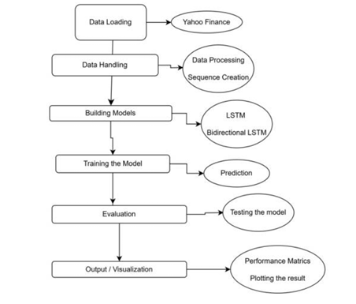
Simulation
Fig. 3. Proposed Flowchart for Forecasting Closing Price of a Stock with different optimizers tested during training and testing

Slide 15
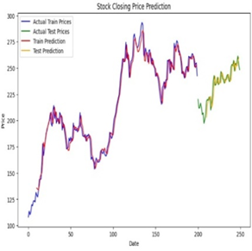
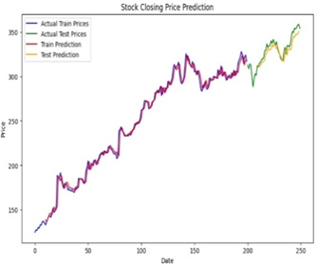
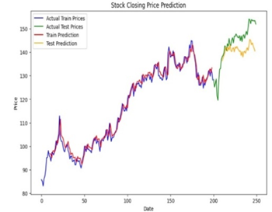
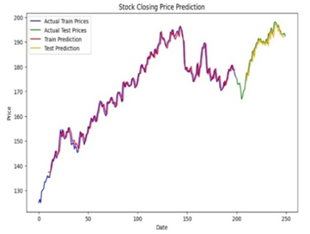
Results and Discussion
Fig.4. Stock prediction of Actual vs Predicted for TESLA | Fig.5. Stock prediction of Actual vs Predicted for META
Fig. 6. Stock prediction of Actual vs Predicted for APPLE | Fig. 7. Stock prediction of Actual vs Predicted for AMAZON

Slide 16
Results and Discussion
Table 3. Error detection in Training Data using Different Optimizer
Optimizer | Company | Training Data |  |  | Testing Data
 |  | MAE | MSE | RMSE | MAE | MSE | RMSE
Adam Optimizer | META | 3.944 | 31.602 | 5.621 | 5.271 | 41.328 | 6.428
 | TESLA | 5.352 | 48.138 | 6.932 | 4.818 | 40.92 | 6.347
 | APPLE | 4.520 | 4.520 | 2.126 | 1.633 | 4.124 | 2.030
 | AMAZON | 1.843 | 5.643 | 2.375 | 5.653 | 43.72 | 6.612
RMS prop Optimizer | META | 4.001 | 35.068 | 5.486 | 3.271 | 21.32 | 4.428
 | TESLA | 5.001 | 42.068 | 6.486 | 5.303 | 46.04 | 6.785
 | APPLE | 1.613 | 4.247 | 2.061 | 1.740 | 4.599 | 2.144
 | AMAZON | 1.843 | 6.643 | 2.375 | 4.653 | 25.72 | 5.612
SGD Optimizer | META | 7.137 | 88.836 | 9.632 | 10.271 | 146.3 | 10.428
 | TESLA | 11.13 | 185.836 | 13.632 | 5.875 | 54.81 | 7.403
 | APPLE | 3.208 | 17.029 | 4.126 | 4.103 | 23.32 | 4.829
 | AMAZON | 1.843 | 5.643 | 2.375 | 4.653 | 28.72 | 5.612
Adagrad Optimizer | META | 3.409 | 15.348 | 3.713 | 11.93 | 175.4 | 3.247
 | TESLA | 11.72 | 204.098 | 14.286 | 5.958 | 55.66 | 7.461
 | APPLE | 3.29 | 17.374 | 4.168 | 4.347 | 25.45 | 5.044
 | AMAZON | 3.086 | 15.378 | 3.921 | 4.717 | 29.47 | 5.428

Slide 17
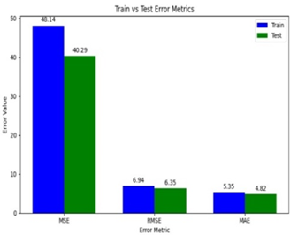
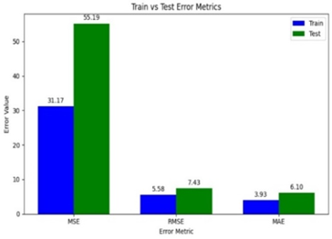
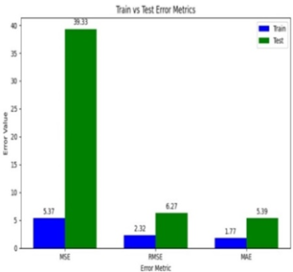
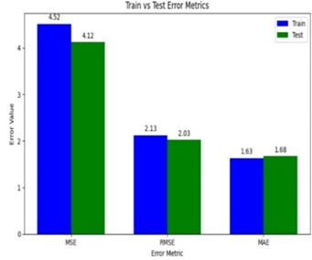
Fig.8. Error evaluation for closing price prediction of Tesla (2023-2024) | Fig.9. Error evaluation for closing price prediction of META (2023-2024)
Fig.10. Error evaluation for closing price prediction of Apple (2023-2024) | Fig.11. Error evaluation for closing price prediction of Amazon (2023-2024)

Slide 18
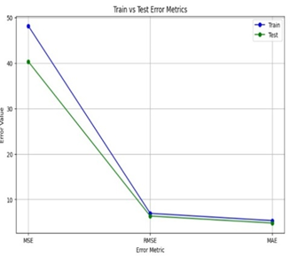
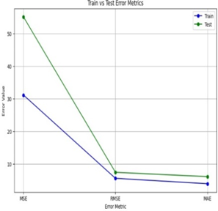
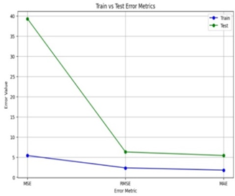
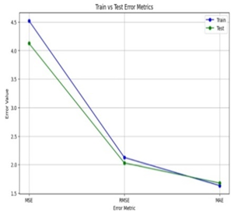
Fig.12. Error in Tesla closing price prediction | Fig.13. Error in Meta closing price prediction
Fig.14. Error in Apple closing price prediction | Fig.15. Error in Amazon closing price prediction

Slide 19
Conclusion
Achieved outputs of Proposed System
This paper presents the successful application of Bi-Long Short-Term Memory (LSTM) networks with different optimizers on stock closing price prediction of META, Amazon, Apple, and Tesla.
With historical stock data, it captures the temporal patterns, which make this LSTM model a good tool for future price forecast.
Evaluation metrics such as MSE, RMSE, and MAE showed that this model was performing reasonably both for the training and testing set in terms of accuracy about which information can be derived from such models.
The Adam optimizer turns to be the most effective here that is because of its properties related to adaptive learning rate and momentum, and, particularly, its ability to accommodate noisy, nonstationary data in finance.

Slide 20
Limitations of Proposed System
Despite the promising results of the study, it highlights many inherent challenges in financial forecasting, such as volatility and external factors that can influence the stock prices. These complexities can affect the model's predictive accuracy, further emphasizing the need for continued refinement.
Future Scope of Proposed System
Future improvements would involve incorporating additional features like trading volume, sentiment analysis, and economic indicators in order to enhance the robustness of the model.

Slide 21
References
[1] Billah, M. M., Sultana, A., Bhuiyan, F., & Kaosar, M. G.: Stock price prediction: compar ison of different moving average techniques using deep learning model. Neural Compu ting and Applications, 36(11), 5861-5871(2024)
[2]. ingh, S., Joshi, K., & Kanna, D.: Stock market price prediction analysis (LSTM vs EMA). In AIP Conference Proceedings (Vol. 3075, No. 1). AIP Publishing, (2024, July).
[3]. Daniswara, D. A., Widjanarko, H., & Hikmah, K.: The Accuracy Test of Technical Analy sis of Moving Average, Bollinger Bands, and Relative Strength Index on Stock Prices of Companies Listed in Index Lq45. Indikator, 6(2), 411842(2022).
[4]. Garraux, H.: The Measure of Potential Profitability in Intraday Trading Utilizing the Rela tive Strength Index (RSI) with Various Simple Moving Averages (SMA) on the S&P 500(2024).
[5]. Karim, R., Alam, M. K., & Hossain, M. R.: Stock market analysis using linear regression and decision tree regression. In 2021 1st International Conference on Emerging Smart Technologies and Applications (eSmarTA) (pp. 1-6). IEEE. (2021, August).
[6 ].HarHartanto, A. D., Kholik, Y. N., & Pristyanto, Y.: Stock Price Time Series Data Forecasting Using the Light Gradient Boosting Machine (LightGBM) Model. JOIV: International Journal on Informatics Visualization, 7(4), 2270-2279(2023).

Slide 22
[7]. Kavinnilaa, J., Hemalatha, E., Jacob, M. S., & Dhanalakshmi, R.: Stock price prediction based on LSTM deep learning model. In 2021 International Conference on System, Com putation, Automation and Networking (ICSCAN) (pp. 1-4). IEEE(2021, July).
[8]. Khanderwal, S., & Mohanty, D.: Stock price prediction using ARIMA model. International Journal of Marketing & Human Resource Research, 2(2), 98-107(2021).
[9]. Yang, H., Liu, X. Y., Zhong, S., & Walid, A.: Deep reinforcement learning for automated stock trading: An ensemble strategy. In Proceedings of the first ACM international confer ence on AI in finance (pp. 1-8) (2020, October).
[10]. Patel, R., Choudhary, V., Saxena, D., & Singh, A. K.: Lstm and nlp based forecasting model for stock market analysis. In 2021 First International Conference on Advances in Computing and Future Communication Technologies (ICACFCT) (pp. 52-57). IEEE(2021, December).
[11]. Jabin, S.: Stock market prediction using feedforward artificial neural network. Internation al Journal of Computer Applications, 99(9), 4-8(2014).
[12] . Gupta, S., & Wang, L. P.: Stock forecasting with feedforward neural networks and gradual data sub-sampling. Australian Journal of Intelligent Information Processing Sys tems, 11(4), 14-17(2010).
[13] .Rubi, M. A., Chowdhury, S., Rahman, A. A. A., Meero, A., Zayed, N. M., & Islam, K. A.: Fitting multi-layer feed forward neural network and autoregressive integrated moving av erage for Dhaka Stock Exchange price predicting. Emerging Science Journal, 6(5), 1046 1061(2022).
[14]. Gu, Y., Shibukawa, T., Kondo, Y., Nagao, S., & Kamijo, S.: Prediction of stock perfor mance using deep neural networks. Applied Sciences, 10(22), 8142(2020).

Slide 23
[15] . Srivinay, Manujakshi, B. C., Kabadi, M. G., & Naik, N.: A hybrid stock price prediction model based on PRE and deep neural network. Data, 7(5), 51(2022).
[16]. Alshammari, T.T. et al.: Forecasting Stock Volatility Using Wavelet-based Exponential Generalized Autoregressive Conditional Heteroscedasticity Methods. Intelligent Automa tion Soft Computing. 35, 2589–601 (2023).
[17]. Toochaei, M. R., & Moeini, F.: Evaluating the performance of ensemble classifiers in stock returns prediction using effective features. Expert Systems with Applications, 213, 119186 (2023).
[18]. Yong, B. X., Abdul Rahim, M. R., & Abdullah, A. S.: A stock market trading system using deep neural network. In Modeling, Design and Simulation of Systems: 17th Asia Simula tion Conference, AsiaSim 2017, Melaka, Malaysia, August 27–29, 2017, Proceedings, Part I 17 (pp. 356-364). Springer Singapore(2017).
[19]. Jahan, I., & Sajal, S.: Stock price prediction using recurrent neural network (RNN) algo rithm on time-series data. In 2018 Midwest instruction and computing symposium. Duluth, Minnesota, USA: MSRP(2018).
[20]. Thong, L., Jeenanunta, C., & Chaysiri, R.: Stock price prediction with long short-term memory recurrent neural network (Doctoral dissertation, Thammasat University) (2018).
[21]. Kamijo, K. I., & Tanigawa, T.: Stock price pattern recognition-a recurrent neural network approach. In 1990 IJCNN international joint conference on neural networks (pp. 215-221). IEEE (1990, June).

Slide 24
Thank you

